Slide 1
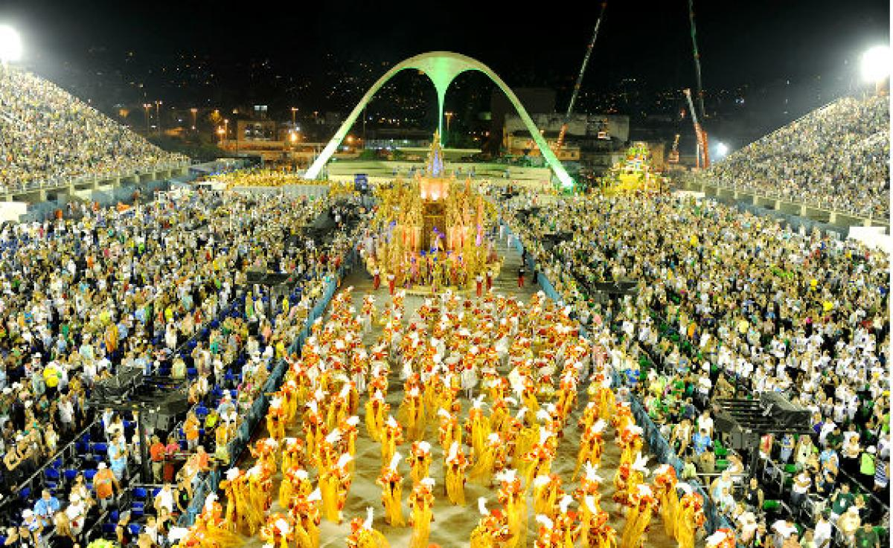
CARNIVAL OF BRAZIL
ELIANA CAICEDO
STIVEN LOPEZ
ANGELA CARDONA
10-2

Slide 2
CARNIVAL OF BRAZIL
The carnival of Brazil is an annual celebration held forty days before Easter, marking the beginning of Lent, dated variable (between February and March depending on the year).

Slide 3
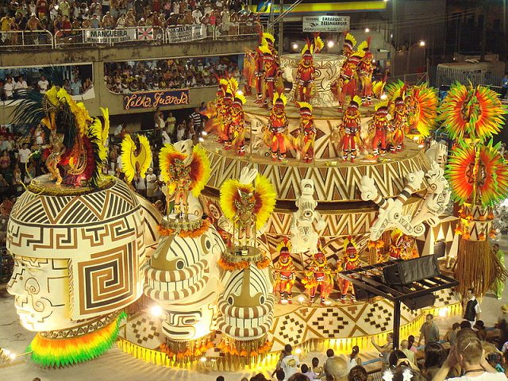
CHARACTERISTICS
This carnival is characterized by,
their parades, joy,
costumes, dances,
excesses and representation
of birds.

Slide 4
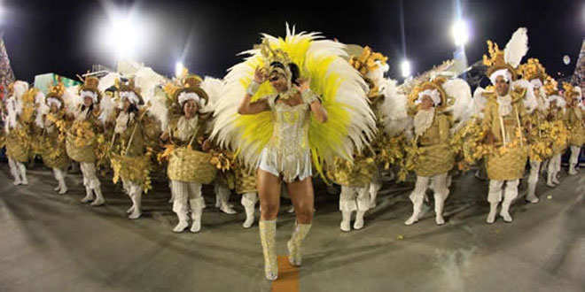
CARNIVAL OF BRAZIL
The main celebrations take place in Rio de Janeiro, Salvador, Recife / Olinda and São Paulo, where the samba schools, blocos and bands occupy entire neighborhoods.

Slide 5
THANK YOU

