Slide 1
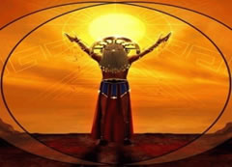
INTI RAIMY
Natalia Chito
Oscar Montoya
I.E Cristóbal Colon
9-1

Slide 2
What is ?
It is a ritual in gratefulness and adoration that make to the sun god for giving light, warm, and life ; the ritual it is carried cut every Winter solstice ( 24 of june ); with the presence of visitor national and foreign that continué this action reborn in the
twentieth century, how considered a religious ceremony.

Slide 3
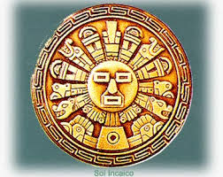
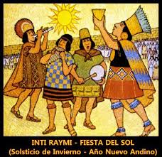
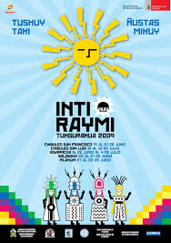
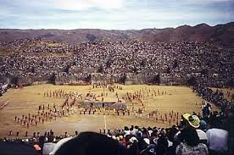

Slide 4
Where it is celebrated ?
The inti raimy is celebrated by the incas
( a indigenous gruop inhabiting in the southwest from colombia and northeast from Perú ) in sacsayhuaman ( as well known as machu picchu ) it is located to two kilometers of the city cuzco ( capital at ethnicity ) .

Slide 5
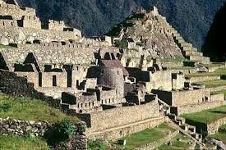
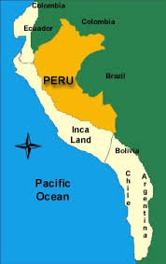
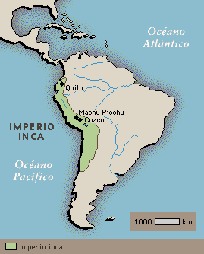
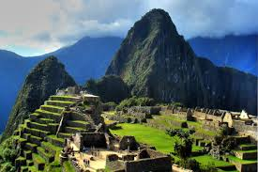

Slide 6
How is performed the ritual ?
Starts agains the cori cancha there an Inca ( King ) ficcional performs in invocation to the sun and choose to a spectator that it is sacrificed to the name of the god sun, becoming in the heir the sun god. After the her invokes to your father the sun.

Slide 7
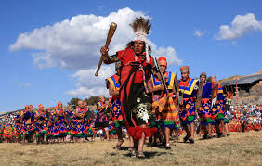
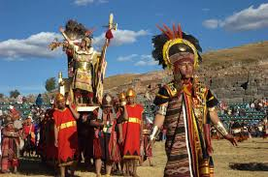
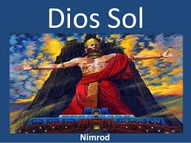
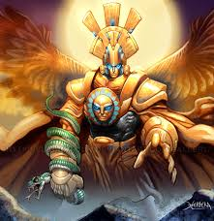
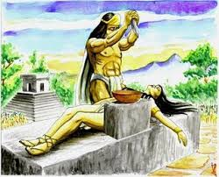

Slide 8
What Is held ?
Inti Raymi is celebrated also to shed laziness, laziness, bad ideas and neglect. Children and adults leave their clothes to dance and bathe in cold water, while a shaman clean their bodies with Nettle and alcohol. The shaman asks for the health and welfare of its people and thanks for the harvest. "Outside, laziness; outside, vagrancy; outside, evil thoughts, "he says while cleaning bodies, with nettle and drink, of those involved in the ritual.

Slide 9
