Slide 1
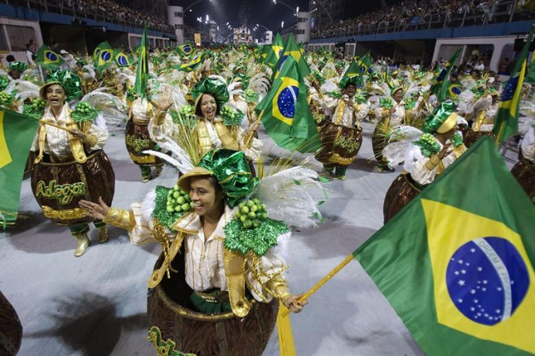
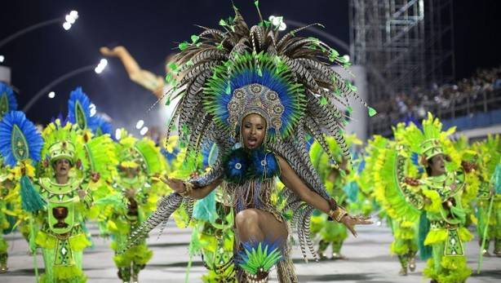
INGLES
PRESENTADO POR :
Alejandra Aguirre
Sara Ocampo
Leidy churta
Laura ramirez

Slide 2
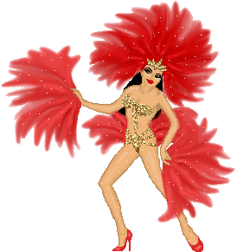
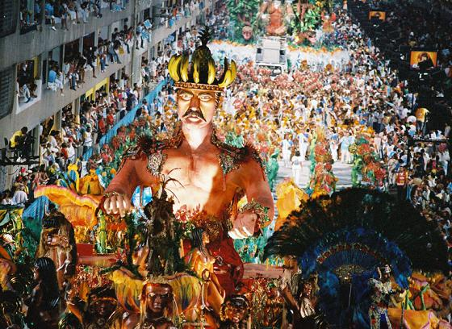
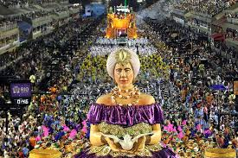
TEMAS
What
were
when
who
How

Slide 3
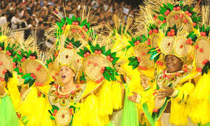
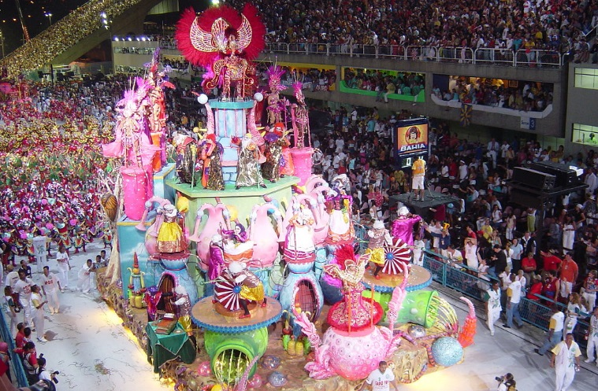
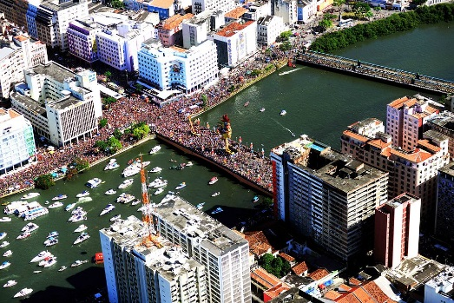
What carnival brazil
Is an anual celebration held forty days before easter,marking the beginning of lent, dated variable (between februray and march dependig on the year ). It has some variations with respect to their
variations with respect to their European counterparts , and also differences over the Brazilian territory.

Slide 4
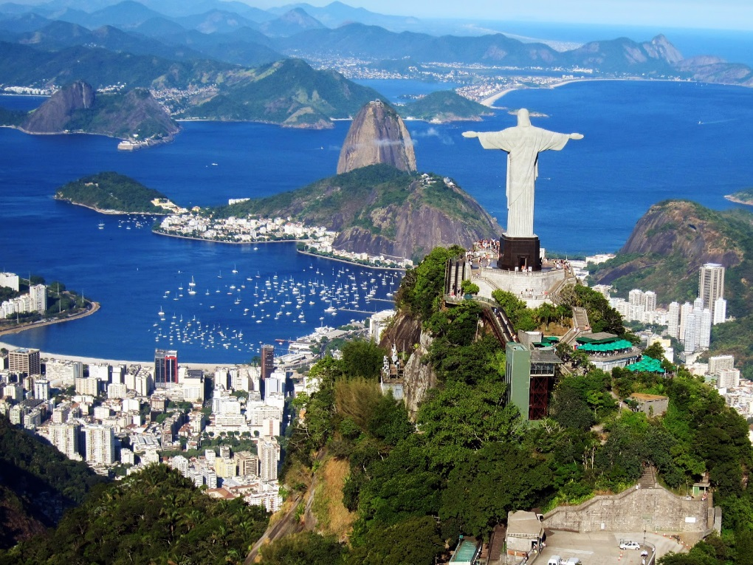
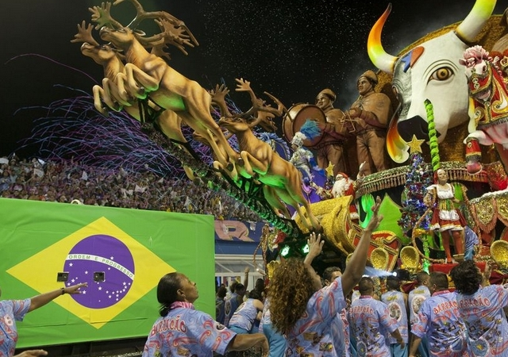
were
Brazil to rio de janeiro

Slide 5
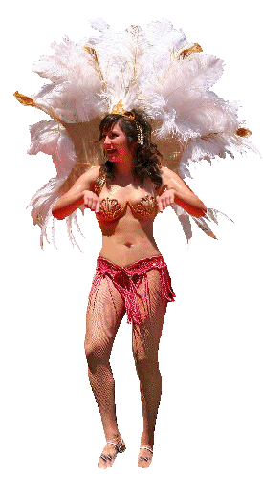
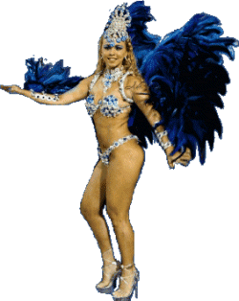
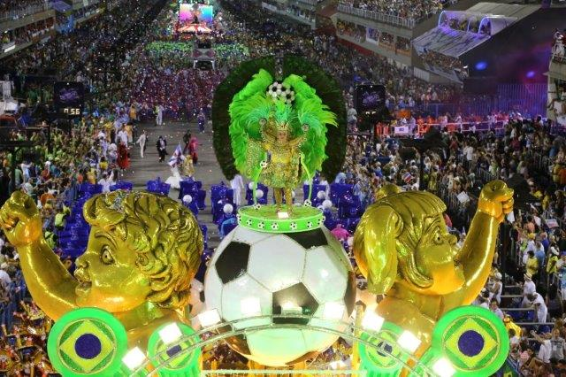
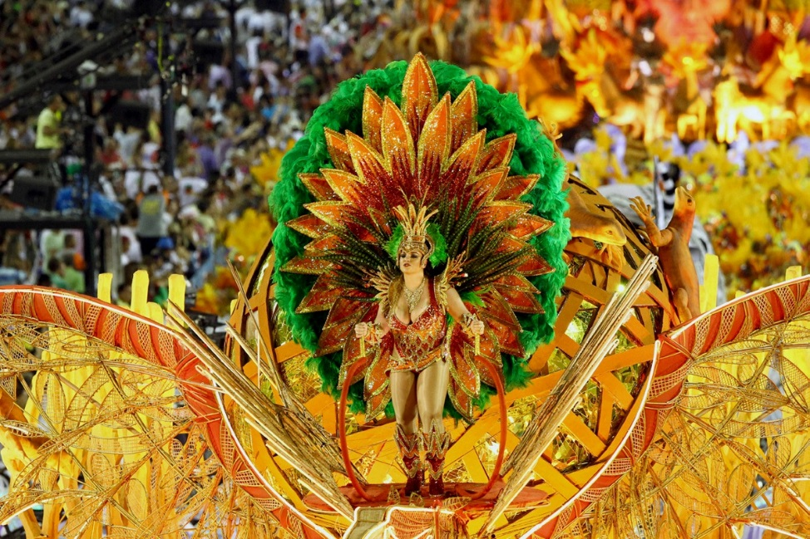
WHEN
March 22 and April 25 Easter is celebrated on the first Sunday after the full moon

Slide 6
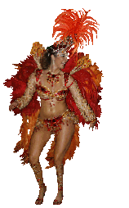
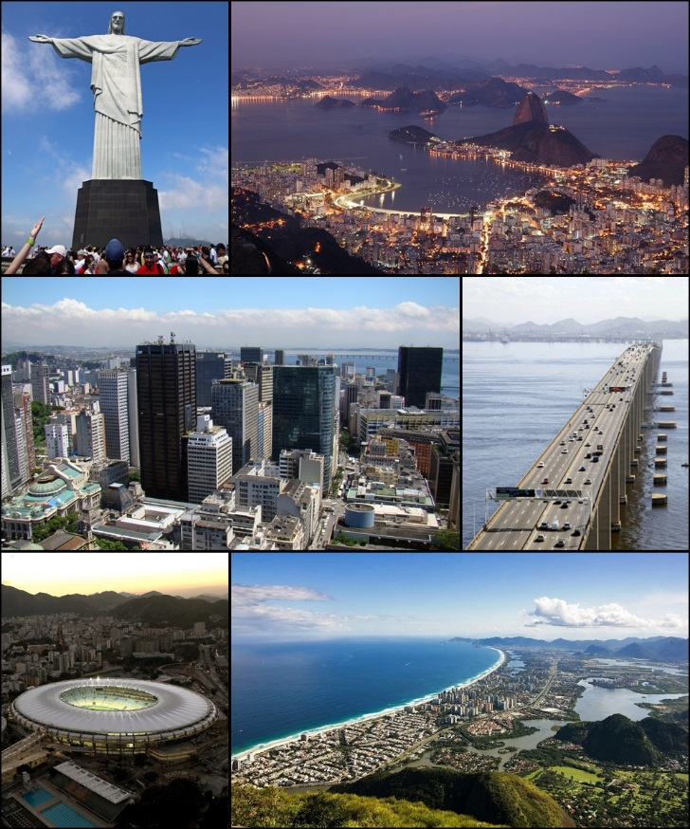
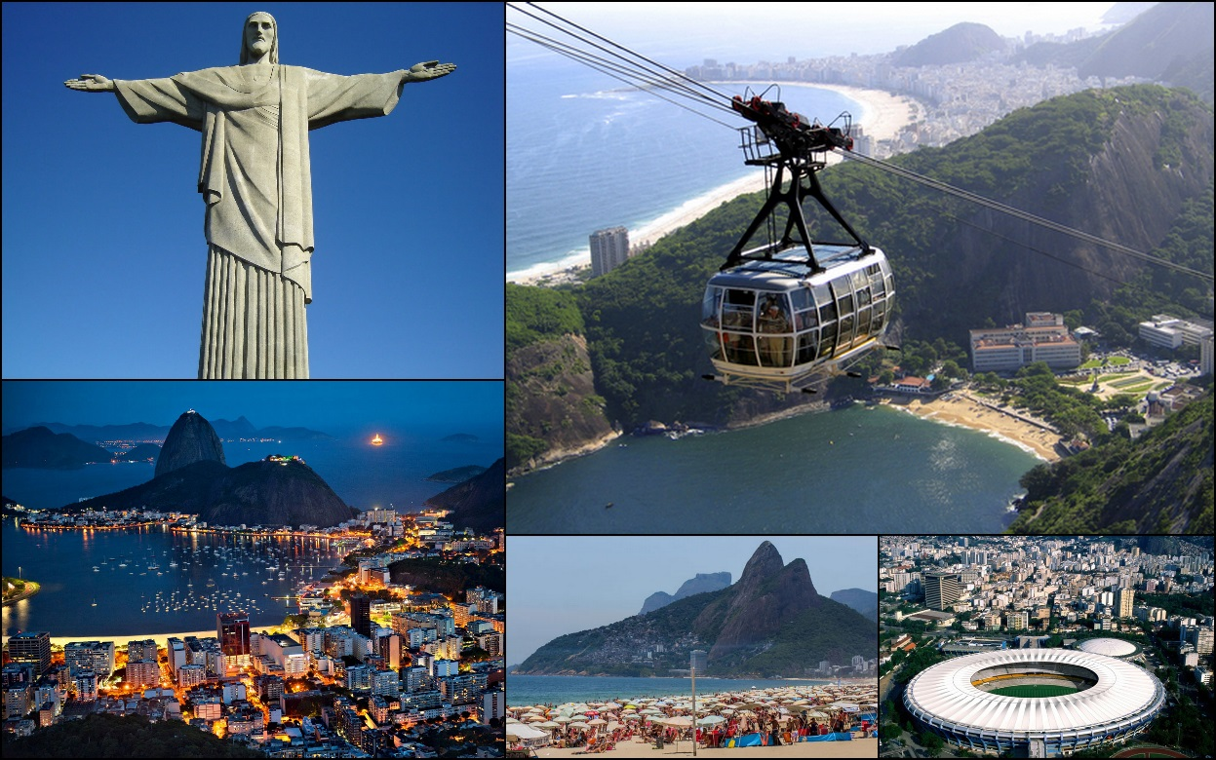
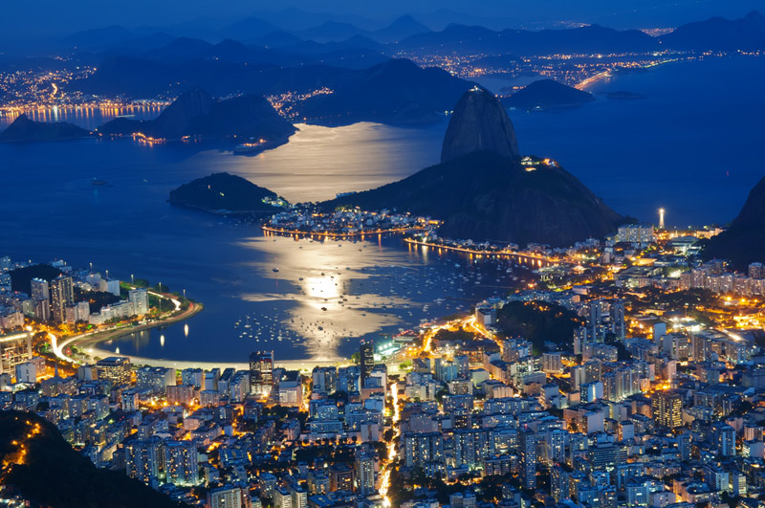
WHO
Brazil gives tuor throughout rio de janeiro

Slide 7
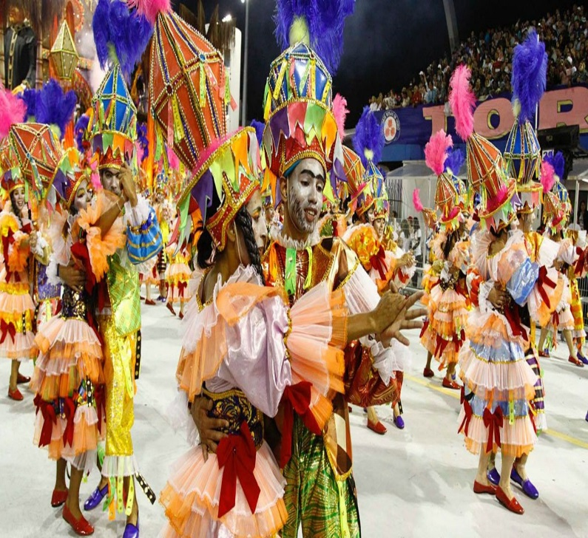
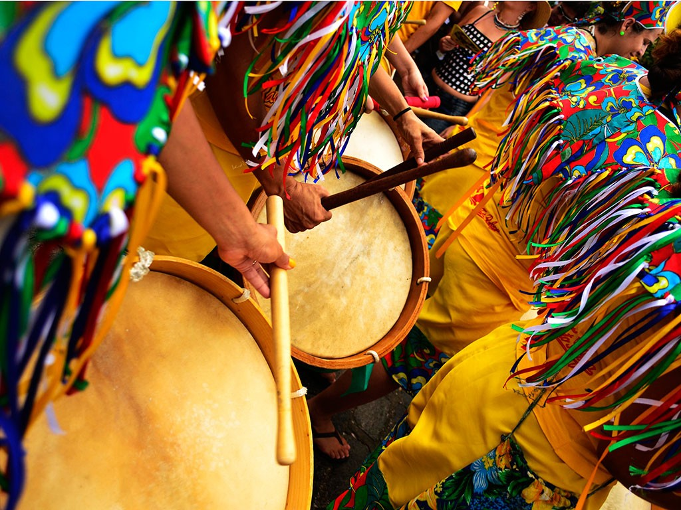
HOW
Besides the nova and samba, bossa famous worldwide , there are several paradigmatic genres that identify Brazilian music and these are also part of the dances

